Slide 1
Chapter 8: Performance
Pingjian Zhang
School of Software Engineering, SCUT
2018

Slide 2
Chapter Outline
What is Performance?
Performance General Scenario
Tactics for Performance
A Design Checklist for Performance
Summary

Slide 3
更高、更快、更强
技术越来越发达
节奏越来越快
耐烦心越来越缺失

Slide 4
What is Performance?
Performance is about time and the software system’s ability to meet timing requirements.
When events occur – interrupts, messages, requests from users or other systems, or clock events marking the passage of time – the system must respond to them in time.
Characterizing the events that can occur (and when they can occur) and the system or element’s time-based response to those events is the essence in discussing performance.

Slide 5
Performance General Scenario
Portion of Scenario | Possible Values
Source | Internal or external to the system
Stimulus | Arrival of a periodic, sporadic, or stochastic event
Artifact | System or one or more components in the system.
Environment | Operational mode: normal, emergency, peak load, overload.
Response | Process events, change level of service
Response Measure | Latency, deadline, throughput, jitter, miss rate

Slide 6
Sample Concrete Performance Scenario
Users initiate transactions under normal operations. The system processes the transactions with an average latency of two seconds.

Slide 7
Goal of Performance Tactics
Tactics to control Performance have as their goal to generate a response to an event arriving at the system within some time-based constraint.

Slide 8
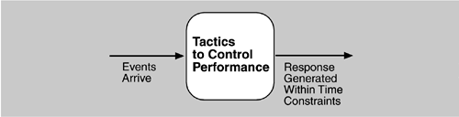
Goal of Performance Tactics

Slide 9
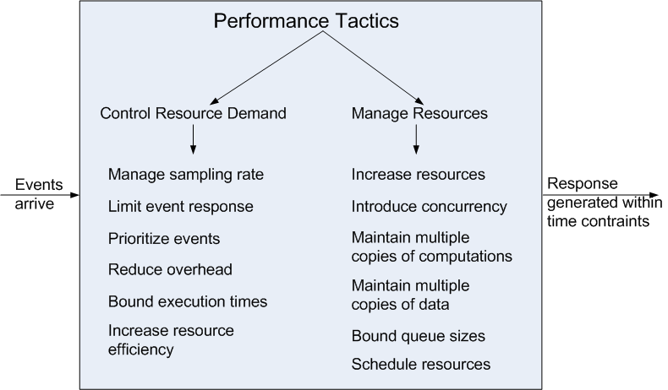
Performance Tactics

Slide 10
Control Resource Demand
Manage Sampling Rate: If it is possible to reduce the sampling frequency at which a stream of data is captured, then demand can be reduced, typically with some loss of fidelity.
Limit Event Response: process events only up to a set maximum rate, thereby ensuring more predictable processing when the events are actually processed.
Prioritize Events: If not all events are equally important, you can impose a priority scheme that ranks events according to how important it is to service them.

Slide 11
Control Resource Demand
Reduce Overhead: The use of intermediaries increases the resources consumed in processing an event stream; removing them improves latency.
Bound Execution Times: Place a limit on how much execution time is used to respond to an event.
Increase Resource Efficiency: Improving the algorithms used in critical areas will decrease latency.

Slide 12
Manage Resources
Increase Resources: Faster processors, additional processors, additional memory, and faster networks all have the potential for reducing latency.
Increase Concurrency: If requests can be processed in parallel, the blocked time can be reduced.
Maintain Multiple Copies of Computations: The purpose of replicas is to reduce the contention that would occur if all computations took place on a single server.
Notes:
在集群上保存多份拷贝、负载均衡

Slide 13
Manage Resources
Maintain Multiple Copies of Data: keeping copies of data (possibly one a subset of the other) on storage with different access speeds.
Bound Queue Sizes: control the maximum number of queued arrivals and consequently the resources used to process the arrivals.
Schedule Resources: When there is contention for a resource, the resource must be scheduled.
Notes:
不同粒度的数据

Slide 14
Design for Performance
Adopt suitable architectural patterns and tactics.
Establish an performance model/formulae.
Design a dedicated performance view if necessary.

Slide 15
Design for Performance
Determine the system’s responsibilities that will involve heavy loading, have time-critical response requirements, are heavily used, or impact portions of the system where heavy loads or time critical events occur. For those responsibilities, identify
processing requirements of each and determine whether they may cause bottlenecks
additional responsibilities to recognize and process requests appropriately including
Responsibilities crossing process or processor boundaries.
Responsibilities to manage the threads.
Responsibilities for scheduling shared resources or managing performance-related queues, buffers, and caches.

Slide 16
Design for Performance
Determine the elements of the system that must coordinate with each, choose communication and coordination mechanisms that
supports any introduced concurrency, event prioritization, or scheduling strategy
ensures that the required performance response can be delivered
have the appropriate properties of the communication mechanisms, for example, stateful, stateless, synchronous, asynchronous, guaranteed delivery, throughput, or latency.

Slide 17
Design for Performance
Determine those portions of the data model that will be heavily loaded, have time critical response requirements, are heavily used, or impact portions of the system where heavy loads or time critical events occur. For those data abstractions, determine
whether maintaining multiple copies of key data would benefit performance
partitioning data would benefit performance
whether reducing the processing requirements/ adding resources to reduce bottlenecks for the creation, initialization, persistence, manipulation, translation, or destruction of the enumerated data abstractions is possible
Notes:
partitioning data 同时提高可维护性和性能

Slide 18
Design for Performance
Determine which resources in your system are critical for performance. For these resources ensure they will be monitored and managed under normal and overloaded system operation.
system elements that need to be aware of, and manage; time and other performance-critical resources
process/thread models
prioritization of resources and access to resources
scheduling and locking strategies
deploying additional resources on demand to meet increased loads

Slide 19
Case Study: Twitter
twitter的注册用户约为1.75亿，并以每天300,000的新用户注册数增长
twitter每月有180万独立访问用户数，并且75%的流量来自twitter.com以外的网站。每天通过API有30亿次请求，每天平均产生5,500次tweet，37%活跃用户为手机用户，约60%的tweet来自第三方的应用。

Slide 20
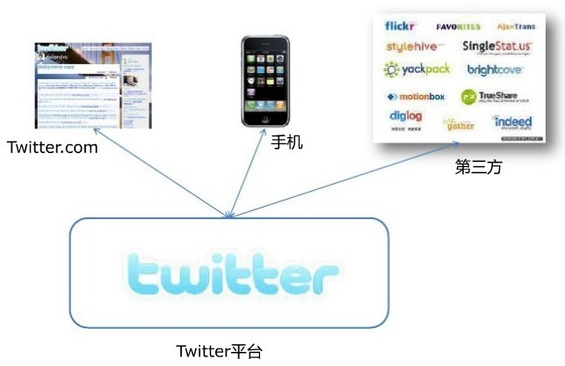

Slide 21
Twitter's Availability Problems
Twitter is, fundamentally, a messaging system. Twitter was not architected as a messaging system, however.
For expediency's sake, Twitter was built with technologies and practices that are more appropriate to a content management system.
Replace existing system, component-by-component, with parts that are designed from the ground up to meet the requirements that have emerged as Twitter has grown.

Slide 22
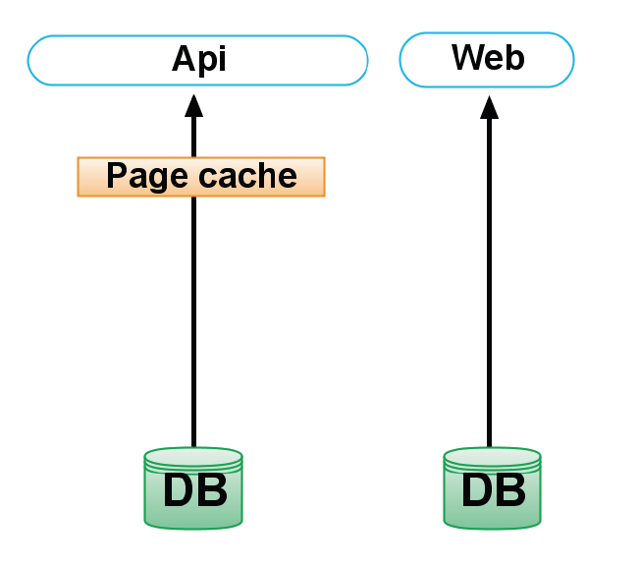
Twitter, an Evolving Architecture
The changes were done in three areas: cache, MQ and Memcached client.

Slide 23
Cache
The first architectural change was to create a write-through Vector Cache containing an array of tweet IDs which are serialized 64 bit integers. This cache has a 99% hit rate.
The second change was adding another write-through Row Cache containing database records: users and tweets. This one has a 95% hit rate.
The third change was introducing a read-through Fragment Cache containing serialized versions of the tweets accessed through API clients which could be packaged in JSON, XML or Atom, with the same 95% hit rate.
Yet another change was creating a separate cache pool for the page cache. The cache misses dropped about 50%.

Slide 24
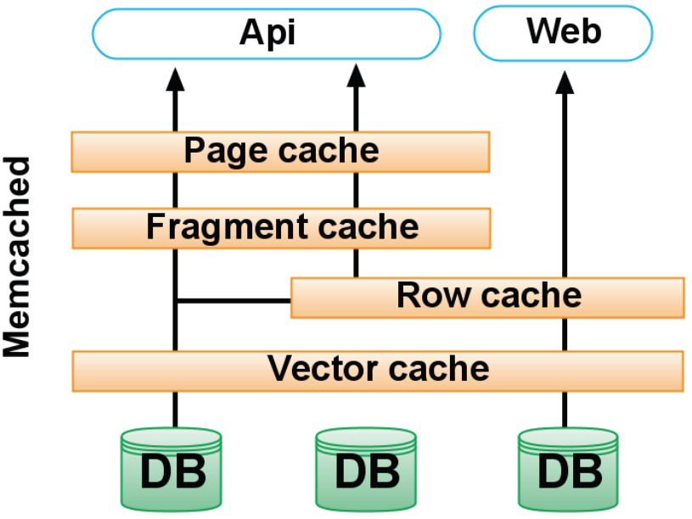

Slide 25
Message Queue
The first implementation of the MQ was using Ruby, and did not scale well especially because Ruby’s GC is not generational.
Port the MQ to Scala which is using the more mature JVM GC.

Slide 26
Memcached Client
Fragment Cache optimization based on libmemcached.

Slide 27
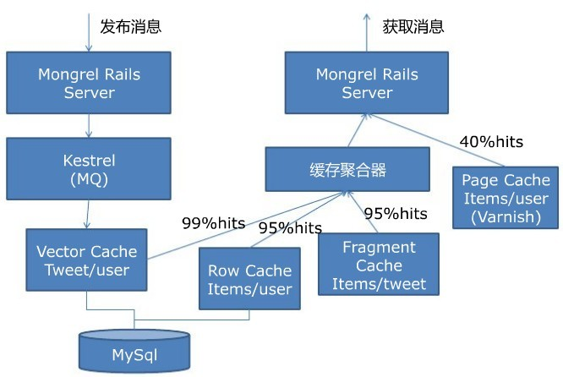

Slide 28
Case Study: Facebook's Challenge
Stats
Over 52 million active users
~50 pages per user
250,000 new users daily
Over 7,000 apps
每个月有超过30亿的图片上传到Facebook
Facebook系统每秒可以处理120万张图片。这还不包括Facebook的CDN处理的图片。
每月处理超过250亿的信息内容（包括用户状态更新，评论等）
Facebook的服务器数量超过3万台（此数据为2009年的数据）

Slide 29
Facebook's Techniques
Memcached：分布式内存缓存系统，为Web服务器和MySQL服务器之间的缓存层
HipHop for PHP：把PHP代码转换成C++代码
Varnish：HTTP加速器，担当负载均衡角色，同时也用于快速处理缓存内容
Haystack：对象存储系统，存储图片
Cassandra：分布式存储系统。用于邮箱搜索
BigPipe：Facebook开发的动态网页处理系统。为了达到最优，Facebook用它来处理每个网页的分块（也称“Pagelets”）
Scribe：灵活多变的日志系统
Hadoop：开源Map/Reduce框架，用于数据分析
Thrift：服务整合

Slide 30
Facebook's Real Time Analytics system
Hadoop Map/Reduce doesn’t fit the real time business

Slide 31
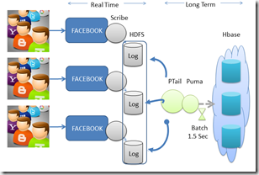
Notes:
Every user activity triggers an asynchronous event, through AJAX – this event is logged in a tail log using Scribe. Ptail is used to aggregate the different individual logs into a consolidated stream. The stream is batched in 1.5 sec groupings by Puma which stores the event batch into HBase. The real time logs are kept for a certain period of time and than get cleared from the system.

Slide 32
Summary
Performance is about the management of system resources in the face of particular types of demand to achieve acceptable timing behavior.
Performance can be measured in terms of throughput and latency for both interactive and embedded real time systems.
Performance can be improved by reducing demand or by managing resources more appropriately.

